Slide 1

DAX (Data Analysis Expressions)

Slide 2
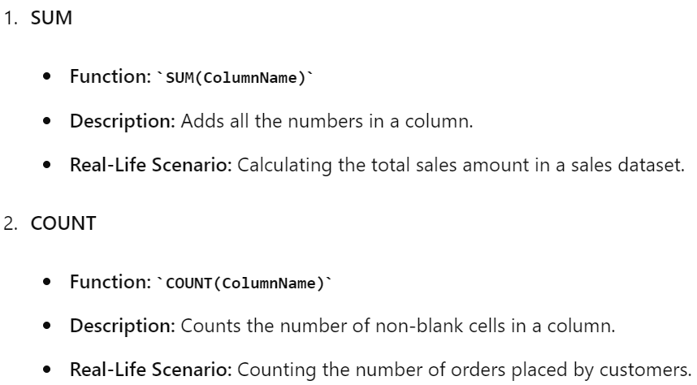
Key DAX Functions: SUM, COUNT, and IF

Slide 3
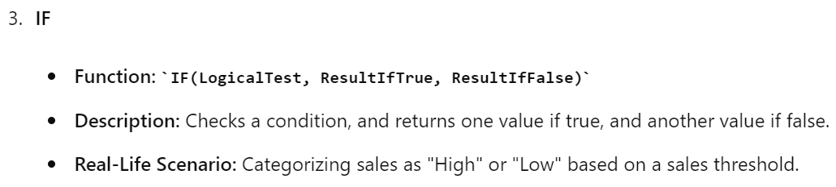

Slide 4
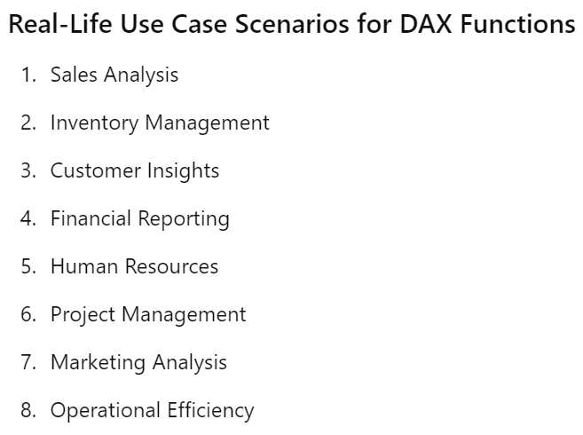

Slide 5
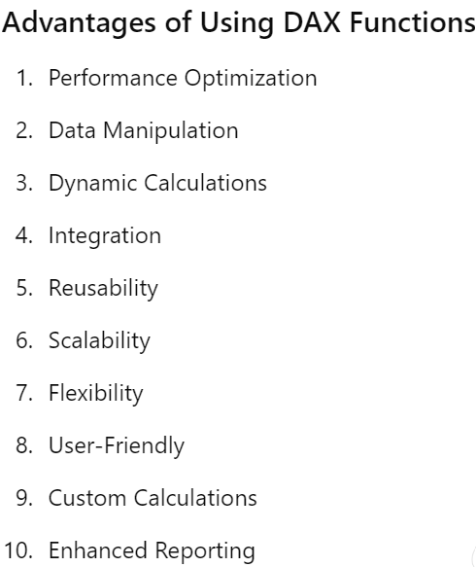

Slide 6
Let’s Implement

